Slide 1
MEDIC-Endorsed Guidelines for Use of PECARN Head CT Decision Rule for Children with Minor Head Injury
Supplemental Material
Last updated: 4/29/2024
Uploaded to website: 5/1/2024

Slide 2
What is MEDIC?
The Michigan Emergency Department Improvement Collaborative (MEDIC) was launched in 2015 as an emergency physician-led quality improvement Collaborative comprised of hospitals across Michigan.
MEDIC partners with emergency physicians who work together to collect and analyze data, identify best practices based on medical evidence, and improve collective performance.
Participating EDs submit data to a clinical registry maintained by the MEDIC Coordinating Center.
Support for MEDIC is provided by Blue Cross Blue Shield of Michigan and Blue Care Network within the BCBSM Value Partnerships program.

Slide 3
Why Standardize ED Guidelines for Head CT Use in Children with Minor Head Injury?
Overuse of head CT for minor head injury in the ED can be reduced through the application of clinical decision rules
Overuse results in excess cost, radiation exposure, follow-up testing for incidental findings, overtreatment due to incidental findings
Variation in care is present within and between EDs driven by
Varying levels of experience and comfort with assessing children
Concerns for liability and risk of missing clinically-important traumatic brain injury
Strong evidence base provides clear indications for CT use in children with mild head injury
Kuppermann N, et al. Identification of children at very low risk of clinically-important brain injuries after head trauma: a prospective cohort study. The Lancet. 2009;374(9696):1160-1170.

Slide 4
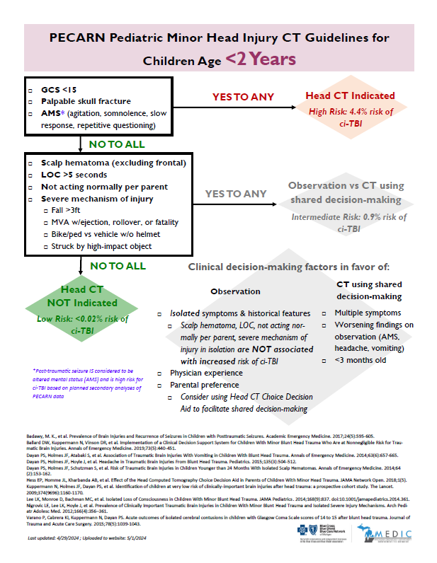
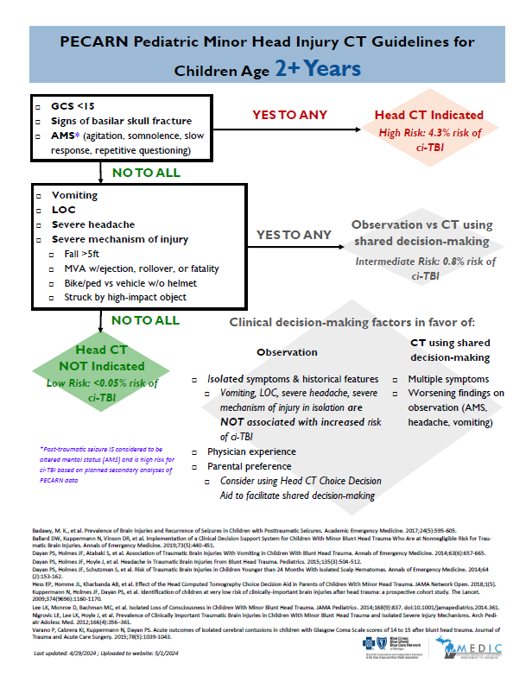
What is this rule?
Internationally recognized
Developed within the ED context for ED providers
Widely utilized as standard-of-care
To improve decision-making for CT ordering in evaluation of pediatric minor head injury
Endorsed by MEDIC after careful, consensus-based vetting process
Kuppermann N, et al. Identification of children at very low risk of clinically-important brain injuries after head trauma: a prospective cohort study. The Lancet. 2009;374(9696):1160-1170.

Slide 5
Why the PECARN Pediatric Head CT Rule?
GOALS
Implement current gold-standard for evidence-based care
Derived prospectively in the ED setting
Extensively studied & validated
Widely utilized as standard-of-care
RATIONALE
LITERATURE
Kuppermann N, et al. Identification of children at very low risk of clinically-important brain injuries after head trauma: a prospective cohort study. The Lancet. 2009;374(9696):1160-1170.

Slide 6
To whom does this rule apply?
GOALS
Define the pediatric population in which the PECARN decision rule can be applied
The PECARN decision rule was studied and validated in the below population:
GCS of 14 - 15
Children within 24 hours of head trauma
Blunt head trauma, not penetrating
More than trivial, but less than severe head injury
Ages < 18
DEFINITION
Kuppermann N, et al. Identification of children at very low risk of clinically-important brain injuries after head trauma: a prospective cohort study. The Lancet. 2009;374(9696):1160-1170.
Lumba-Brown A, et al. Centers for Disease Control and Prevention Guideline on the Diagnosis and Management of Mild Traumatic Brain Injury Among Children [published correction appears in JAMA Pediatr. 2018 Nov 1;172(11):1104]. JAMA Pediatr. 2018;172(11):e182853.
LITERATURE

Slide 7
Why tailor to <2 years & ≥2 years?
To acknowledge the differences in communication and physiologic development of children younger than 2 years of ago and those who are 2 years and older
GOALS
RATIONALE
The landmark PECARN article utilized the age cut point of < 2 and greater than/equal to 2 years to differentiate between the decision rules for pre-verbal and verbal children
LITERATURE
Kuppermann N, et al. Identification of children at very low risk of clinically-important brain injuries after head trauma: a prospective cohort study. The Lancet. 2009;374(9696):1160-1170.

Slide 8
What should I do if my patient has isolated vomiting, LOC, severe headache, severe mechanism of injury?
To minimize CT use among intermediate risk patients with isolated vomiting, loss of consciousness (LOC), severe headache, or severe mechanism of injury
GOALS
Planned secondary analyses of the clinical features that make up the PECARN decision rule have revealed that several symptoms in isolation are not associated with clinically-important traumatic brain injury in children
If a child is experiencing an isolated symptom, a provider can use shared decision making with family members to consider the risk-benefit of observation vs. obtaining a CT
RATIONALE
Dayan PS, et al. Association of Traumatic Brain Injuries With Vomiting in Children With Blunt Head Trauma. Annals of Emergency Medicine. 2014;63(6):657-665.
Dayan PS, et al. Headache in Traumatic Brain Injuries From Blunt Head Trauma. Pediatrics. 2015;135(3):504-512.
Lee LK, et al. Isolated Loss of Consciousness in Children With Minor Blunt Head Trauma. JAMA Pediatrics. 2014;168(9):837.
Nigrovic LE, et al. Prevalence of Clinically Important Traumatic Brain Injuries in Children With Minor Blunt Head Trauma and Isolated Severe Injury Mechanisms. Arch Pediatr Adolesc Med. 2012;166(4):356–361
LITERATURE

Slide 9
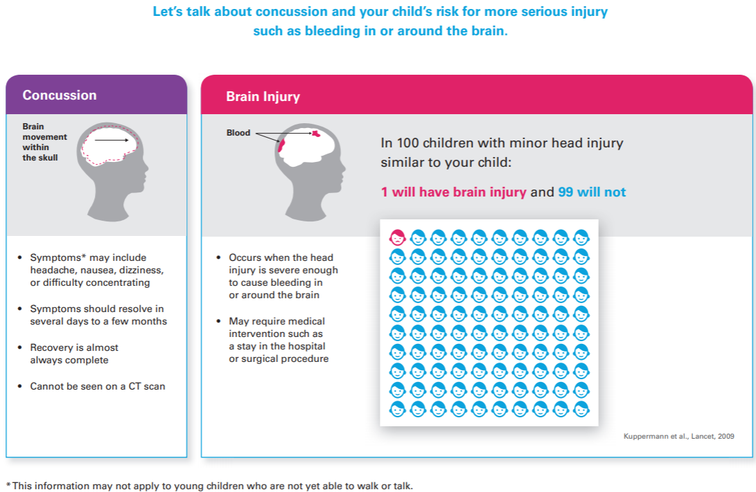
Why the Head CT Choice Decision Aid?
To facilitate shared decision-making with families of children who are in the intermediate risk group for clinically-important traumatic brain injury
GOALS
Shared decision-making tools have been shown to help patients and families make clinical decisions in partnership with their healthcare providers
The Head CT Choice Decision Aid was specifically designed & tested for facilitating conversations in the ED with parents/guardians of children with minor head injury around decision to image
RATIONALE
Hess EP, et al. Effect of the Head Computed Tomography Choice Decision Aid in Parents of Children With Minor Head Trauma. JAMA Network Open. 2018;1(5).
Knowledge and Evaluation Research Unit, https://carethatfits.org/head-ct-choice-desicion-aid/. Accessed December 2020.
LITERATURE

Slide 10
What is this rule?
Internationally recognized
Developed within the ED context for ED providers
Widely utilized as standard-of-care
To improve decision-making for CT ordering in evaluation of pediatric minor head injury
Endorsed by MEDIC after careful, consensus-based vetting process
Kuppermann N, et al. Identification of children at very low risk of clinically-important brain injuries after head trauma: a prospective cohort study. The Lancet. 2009;374(9696):1160-1170.

Slide 11
Post-traumatic seizure in the PECARN rule
Post-traumatic seizure (PTS)
Is considered to be altered mental status (AMS) and is high risk for ci-TBI based on planned secondary analyses of PECARN data
This is true for BOTH < 2 and > 2 y/o children
In the rule, this means clinicians follow box 1 → YES for both age categories and CT IS indicated.
If PTS is present in EHR documentation – abstractors record / check BOTH AMS and LOC boxes in the data registry.
Badawy, M. K., et al. Prevalence of Brain Injuries and Recurrence of Seizures in Children with Posttraumatic Seizures. Academic Emergency Medicine. 2017;24(5):595-605.

Slide 12
Key References
Badawy, M. K., et al. Prevalence of Brain Injuries and Recurrence of Seizures in Children with Posttraumatic Seizures. Academic Emergency Medicine. 2017;24(5):595-605.
Ballard DW, et al. Implementation of a Clinical Decision Support System for Children With Minor Blunt Head Trauma Who Are at Nonnegligible Risk for Traumatic Brain Injuries. Annals of Emergency Medicine. 2019;73(5):440-451.
Dayan PS, et al. Association of Traumatic Brain Injuries With Vomiting in Children With Blunt Head Trauma. Annals of Emergency Medicine. 2014;63(6):657-665.
Dayan PS, et al. Headache in Traumatic Brain Injuries From Blunt Head Trauma. Pediatrics. 2015;135(3):504-512.
Dayan PS, et al. Risk of Traumatic Brain Injuries in Children Younger than 24 Months With Isolated Scalp Hematomas. Annals of Emergency Medicine. 2014;64(2):153-162.
Hess EP, et al. Effect of the Head Computed Tomography Choice Decision Aid in Parents of Children With Minor Head Trauma. JAMA Network Open. 2018;1(5).
Knowledge and Evaluation Research Unit, https://carethatfits.org/head-ct-choice-desicion-aid/. Accessed December 2020.
Kuppermann N, et al. Identification of children at very low risk of clinically-important brain injuries after head trauma: a prospective cohort study. The Lancet. 2009;374(9696):1160-1170.
Lee LK, et al. Isolated Loss of Consciousness in Children With Minor Blunt Head Trauma. JAMA Pediatrics. 2014;168(9):837.
Lumba-Brown A, et al. Centers for Disease Control and Prevention Guideline on the Diagnosis and Management of Mild Traumatic Brain Injury Among Children [published correction appears in JAMA Pediatr. 2018 Nov 1;172(11):1104]. JAMA Pediatr. 2018;172(11):e182853.
Nigrovic LE, et al. Prevalence of Clinically Important Traumatic Brain Injuries in Children With Minor Blunt Head Trauma and Isolated Severe Injury Mechanisms. Arch Pediatr Adolesc Med. 2012;166(4):356–361.
Varano P, et al. Acute outcomes of isolated cerebral contusions in children with Glasgow Coma Scale scores of 14 to 15 after blunt head trauma. Journal of Trauma and Acute Care Surgery. 2015;78(5):1039-1043.

